Slide 1




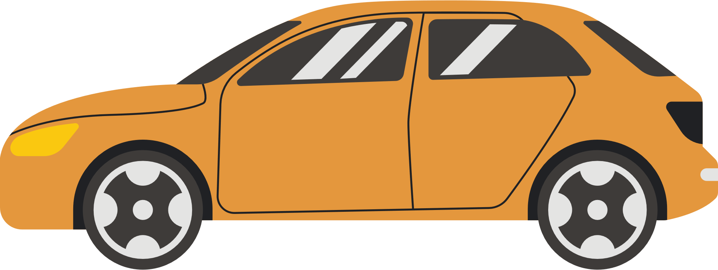

Traffic Density estimator
1

Slide 2


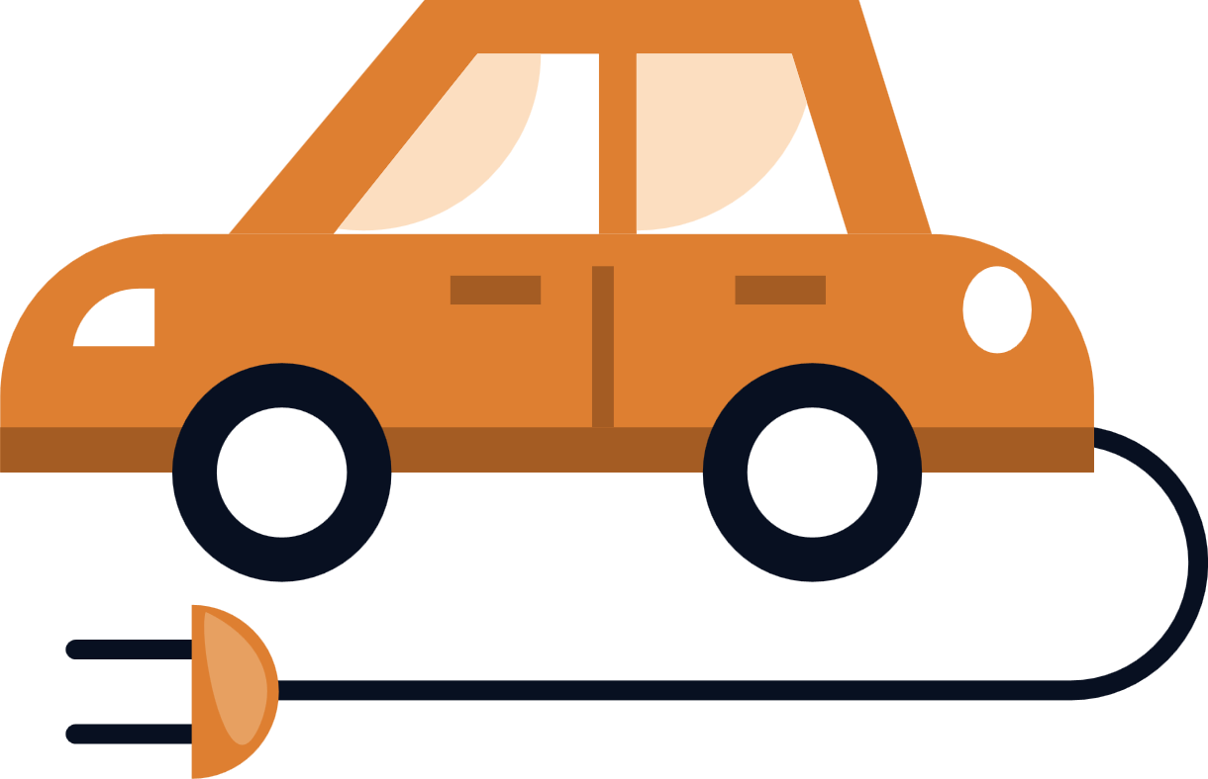
problem statment
Objective: To develop a system that predicts traffic congestion and notifies drivers when more than 10 cars are on the road
.
Importance: Helps in reducing travel time, improving safety, and enhancing overall traffic management.
2

Slide 3
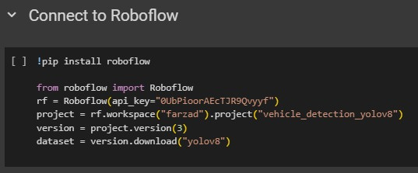
data collection
3

Slide 4
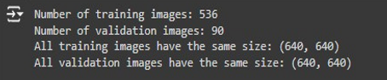
EDA
4

Slide 5
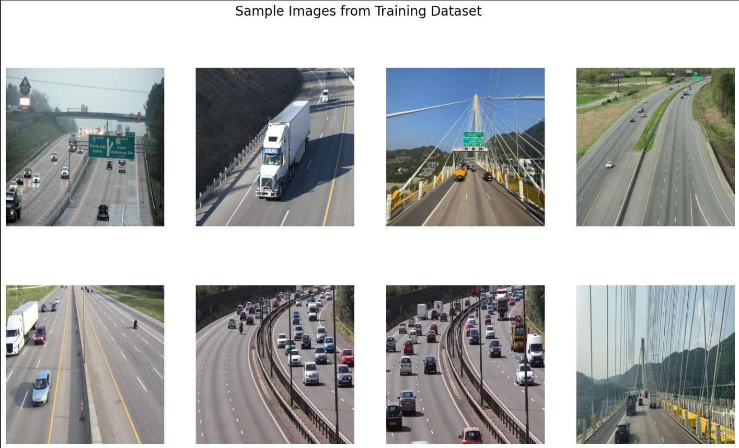
EDA
5

Slide 6

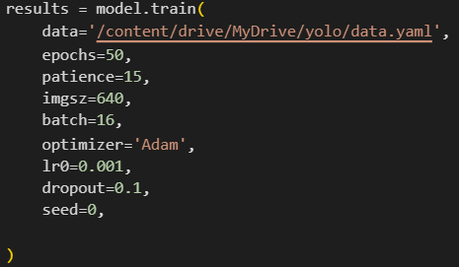
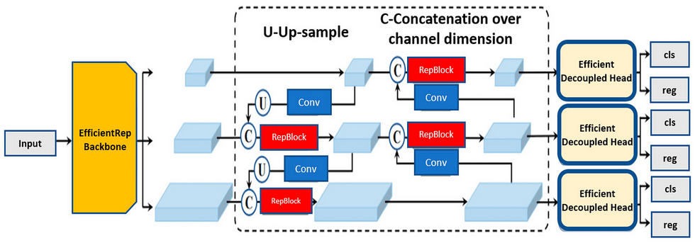


Methodology
Step 1: Collect data
Download data from Roboflow
Model description:
YOLO is suitable for this task due to its real-time object detection capability. It excels in both accuracy and speed when identifying bounding boxes around objects.
6

Slide 7
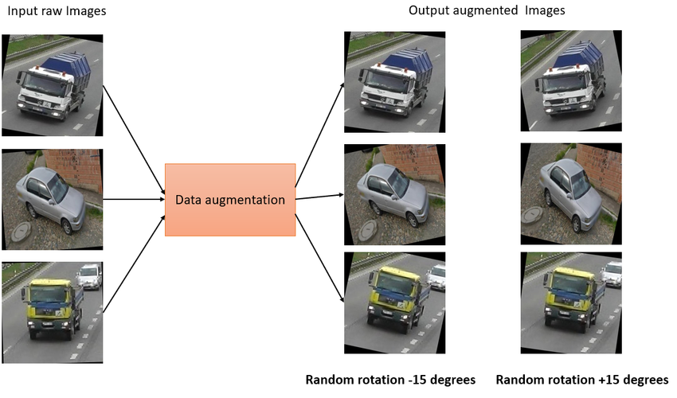
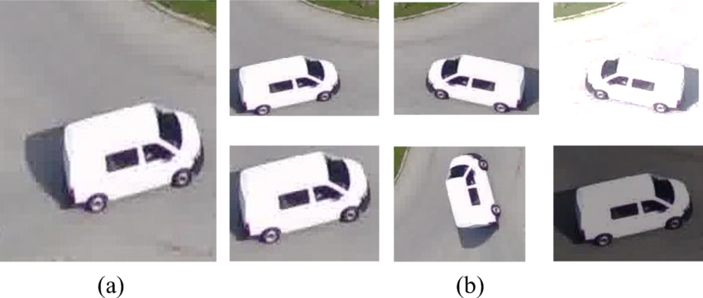


data preprocessing and Augmentation
7

Slide 8
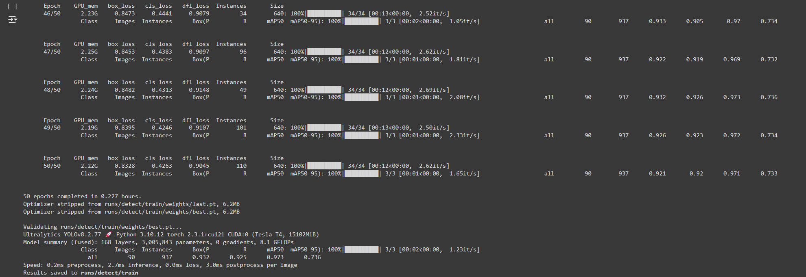
Model Training
8

Slide 9
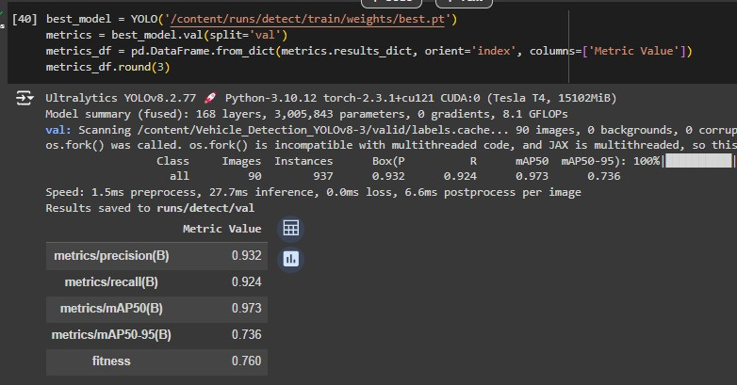
Evaluation
9

Slide 10
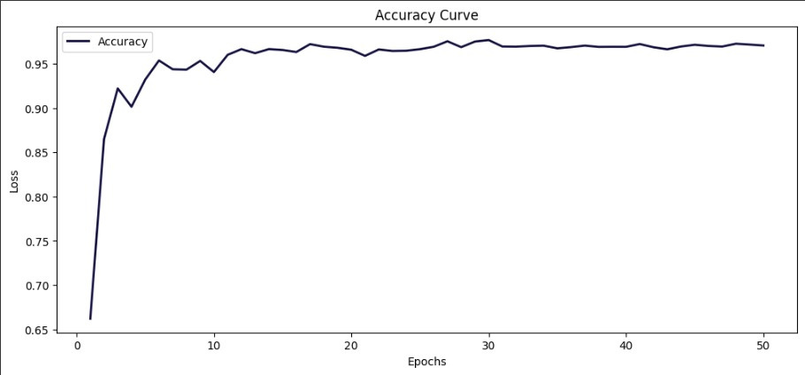
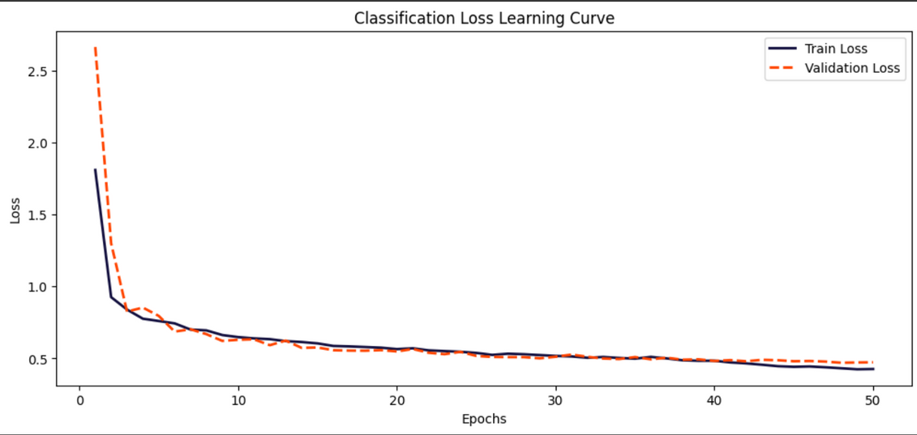
Accuracy Curve
Classification Loss Learning Curve
10

Slide 11
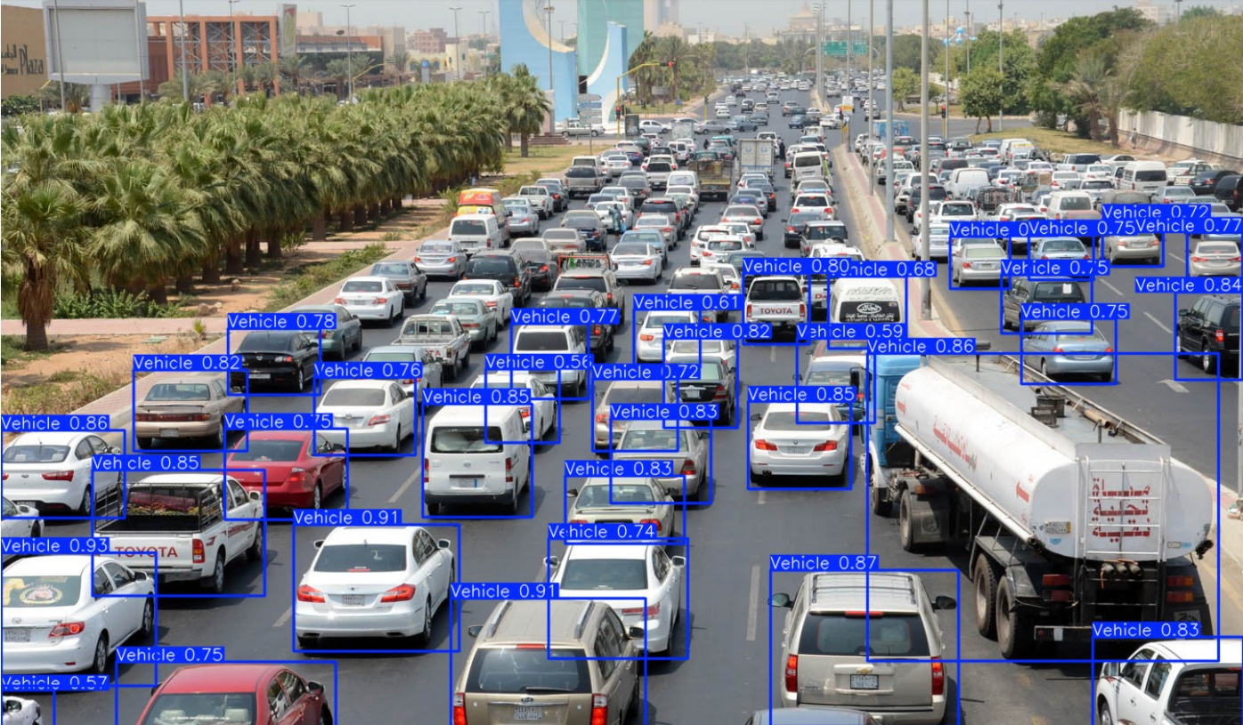
Results
11

Slide 12
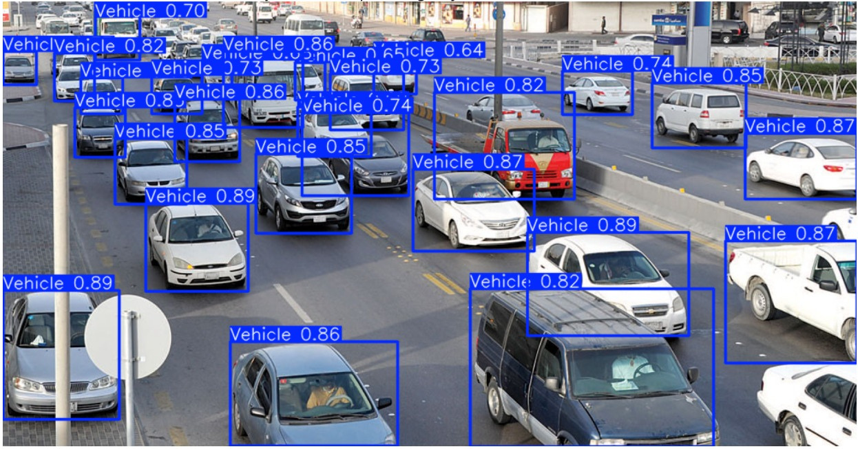
Results
12

Slide 13
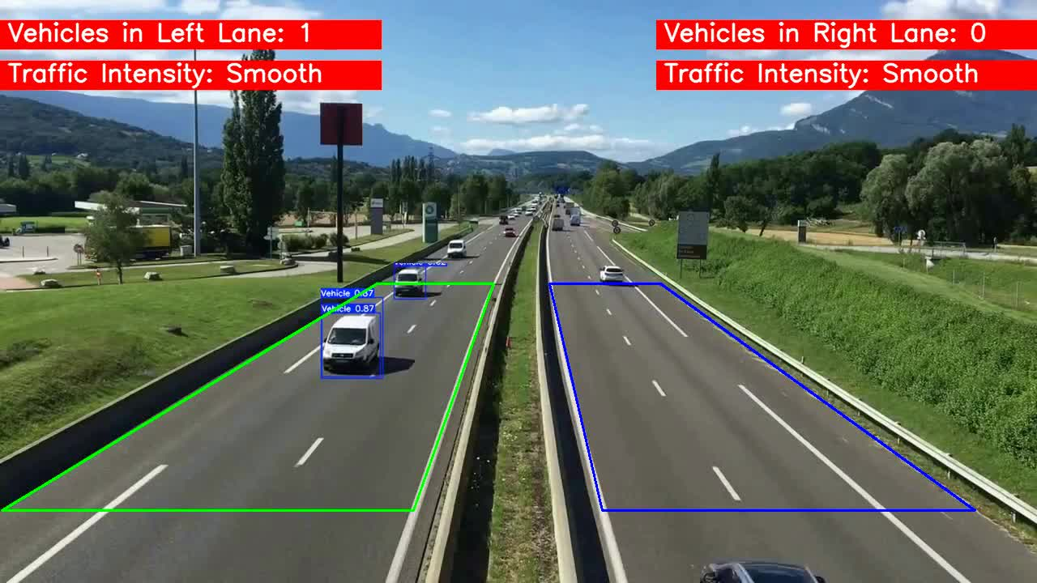
Results
13

Slide 14
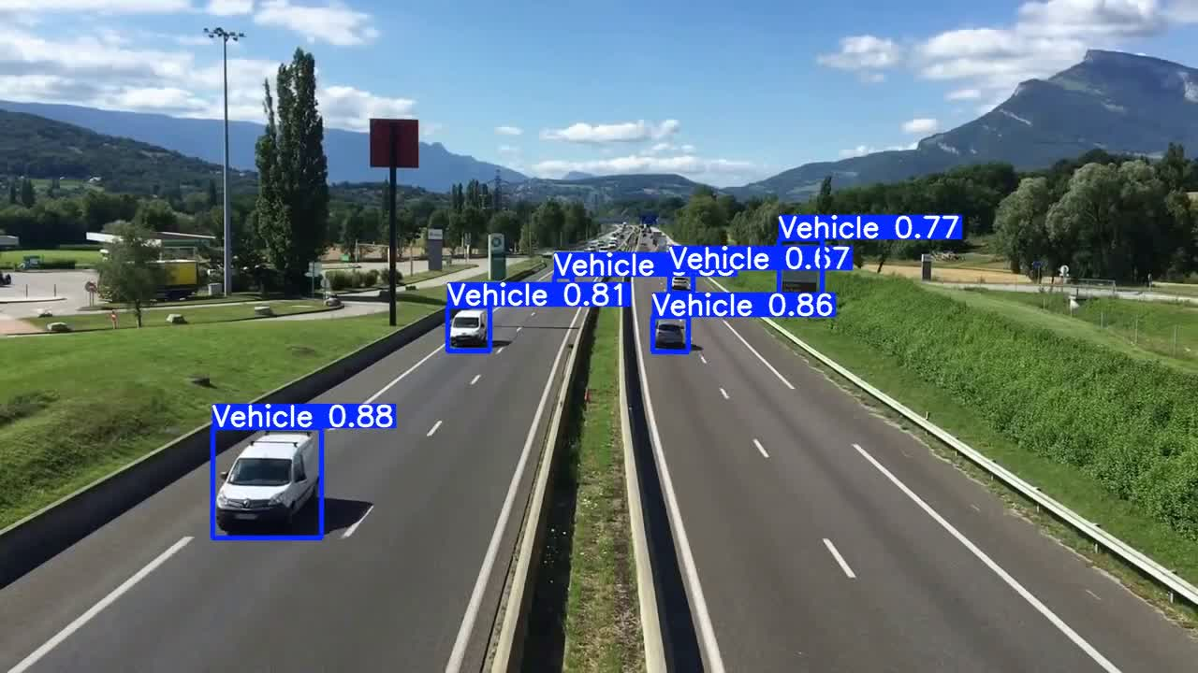
Results
14

Slide 15

Presentation Questions:
1. What challenges did you face during data collection and how did you overcome
them?
2. Why did you choose your specific model architecture?
3. How does the performance of your chosen model compare to the alternative
approaches, and what factors contributed to the differences?
4. What did you learn from storing the data in a database, and how did it impact you
workflow?
5. If you were to extend this project, what additional features or improvements would
you consider?
15

Slide 16
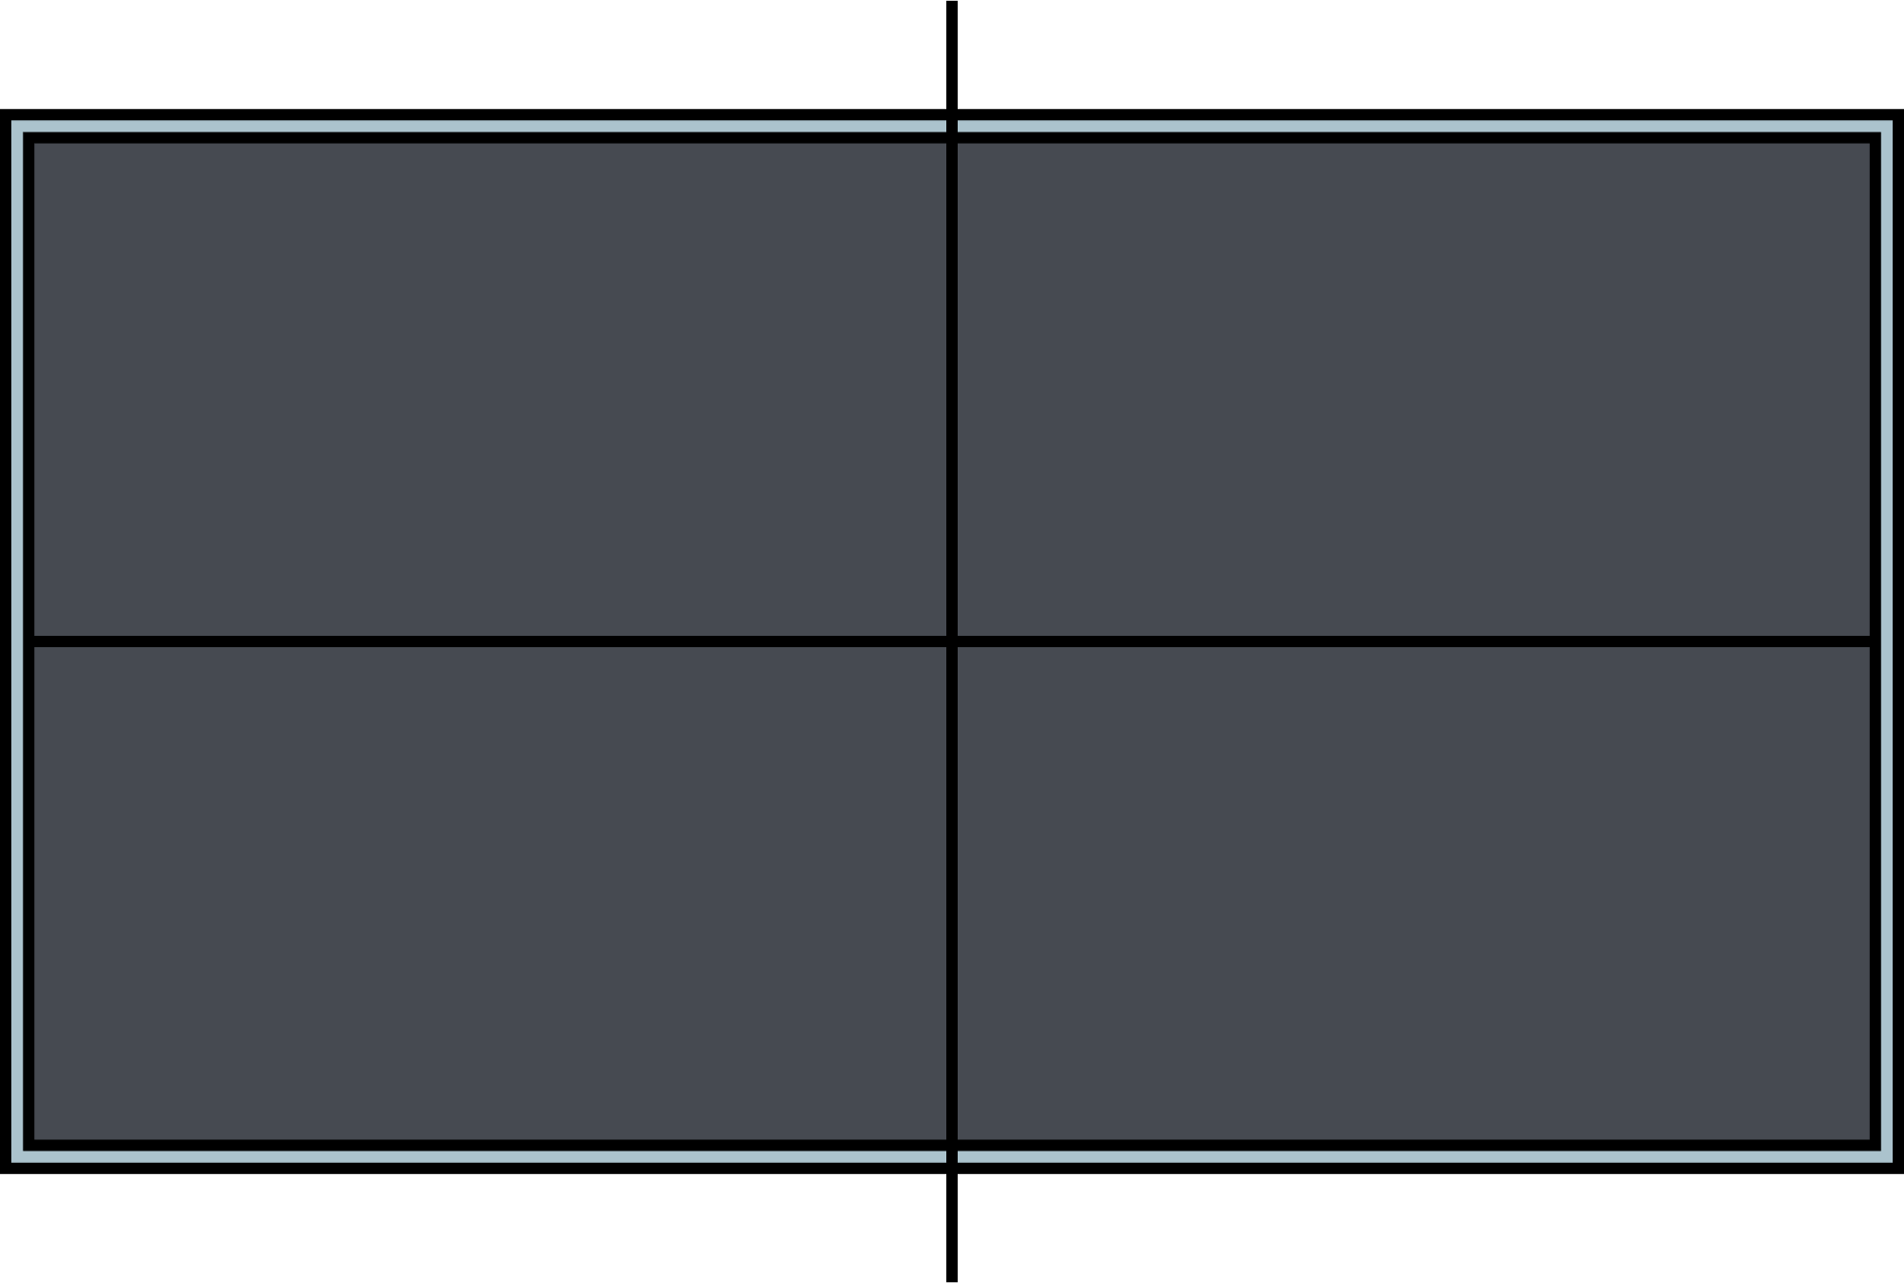
entire workflow
Dataset Collection
preprocessing
Model training
report
presentation
Reshoof Alzweaid
Abdullah AlOwais
Rahaf Hasan
Afrah Jaber
17

Slide 17
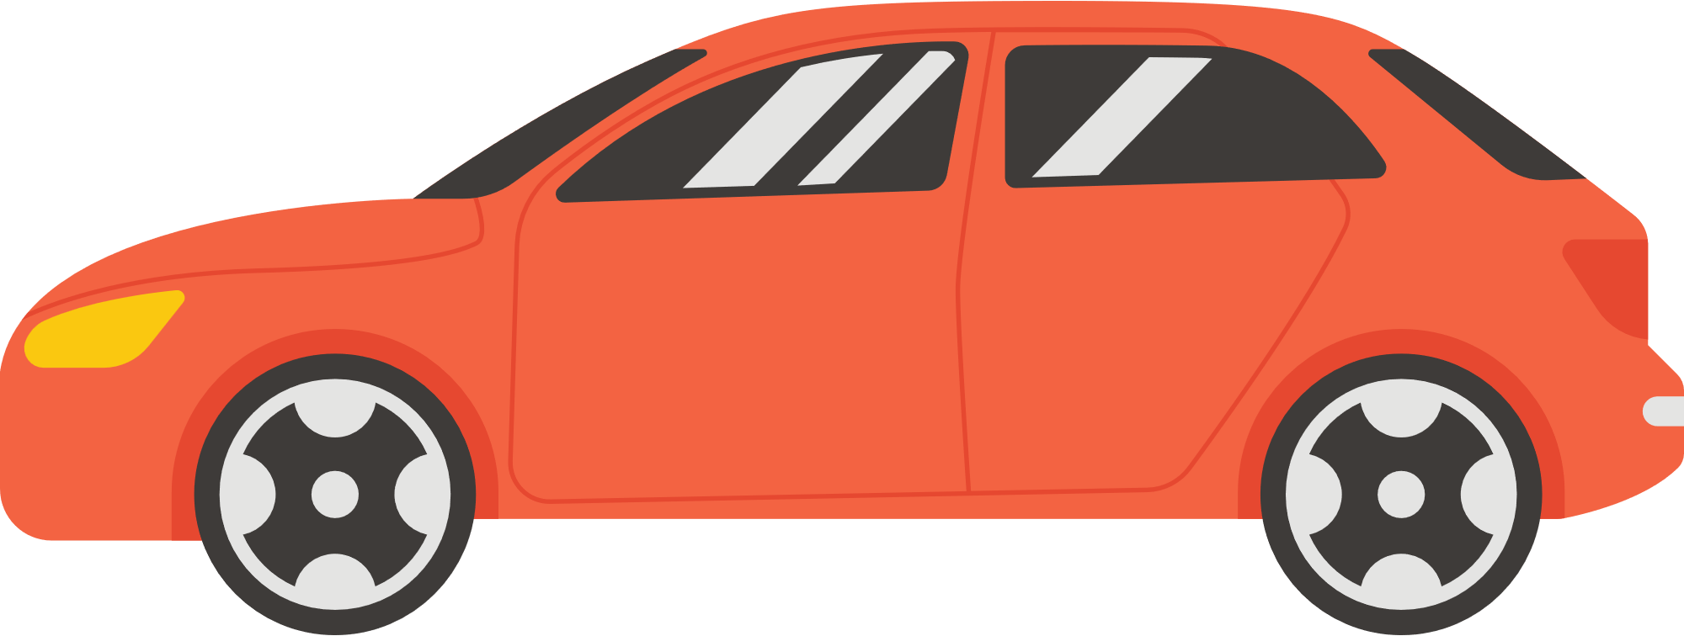

Thank You

